Slide 1
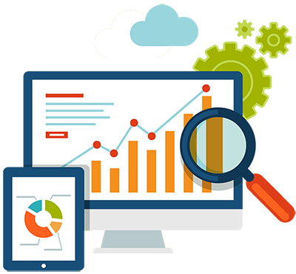
Data Acquisition

Slide 2

Selenium is a portable framework for testing web applications.
It can be used with many programming languages, including C#,
Java and Python.
It’s compatible with most web browsers.

Slide 3
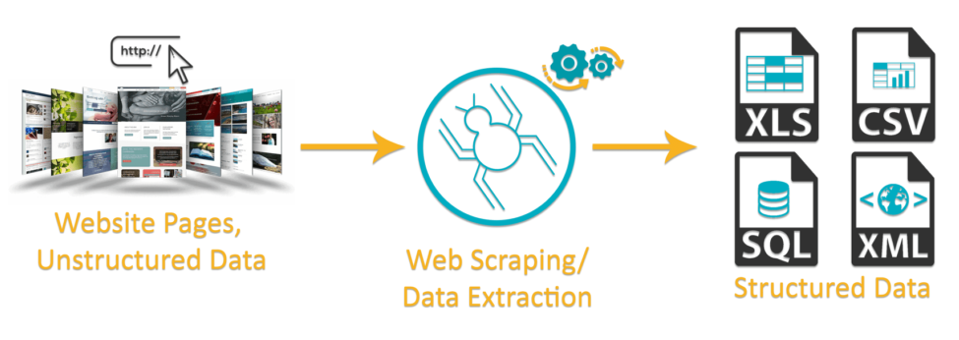
Web Scraping
1. Fetching a Web page
2. Extracting from it

Slide 4
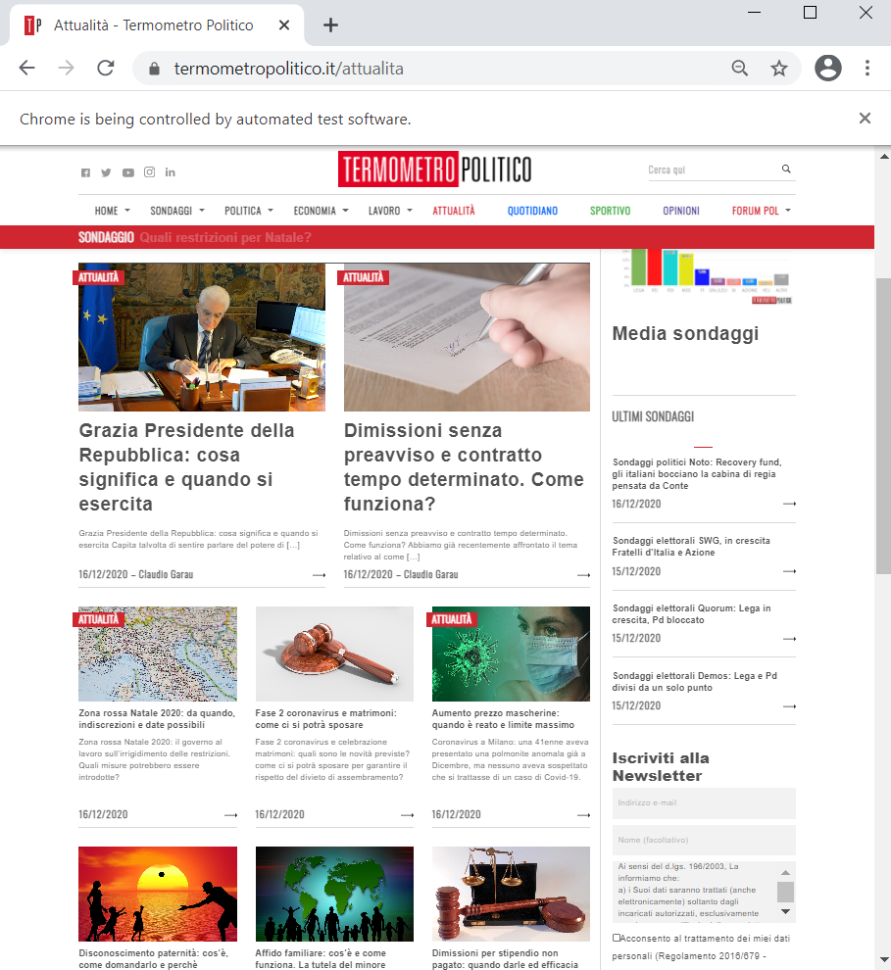
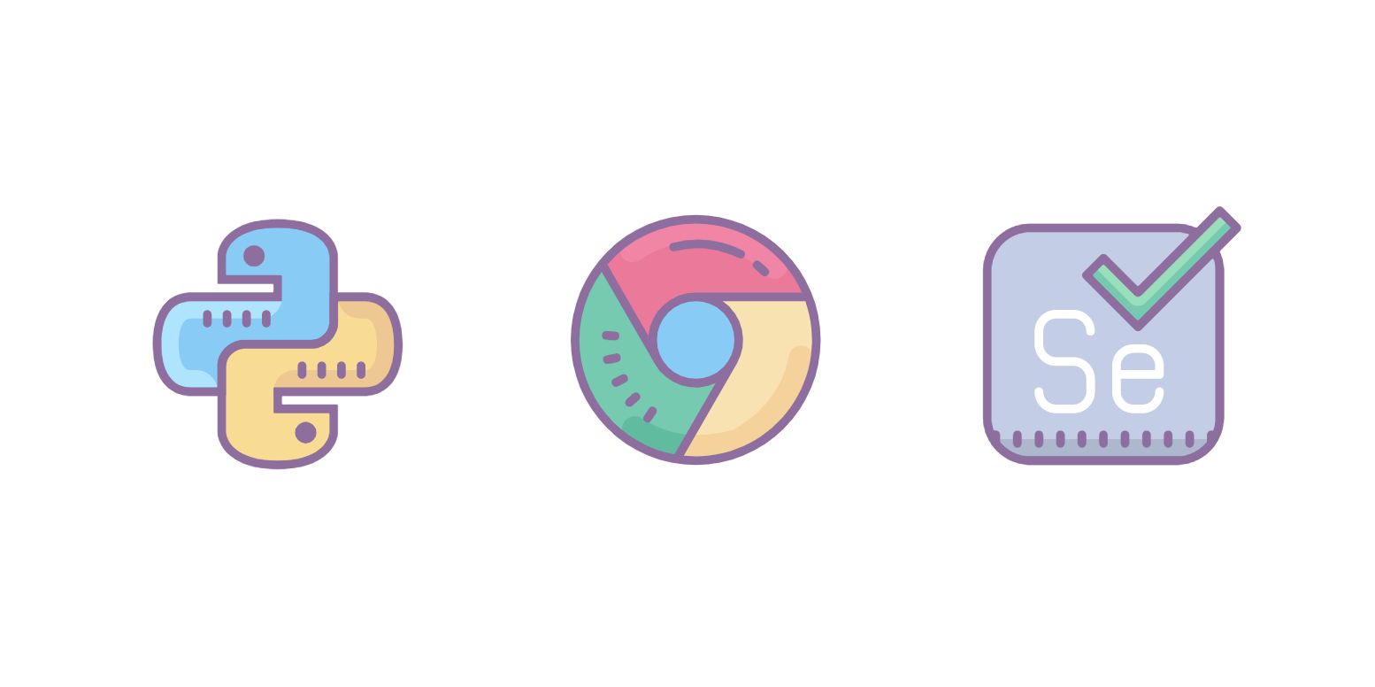
1. Fetching a Web page
driver = webdriver.Chrome()
driver.get(URL)

Slide 5
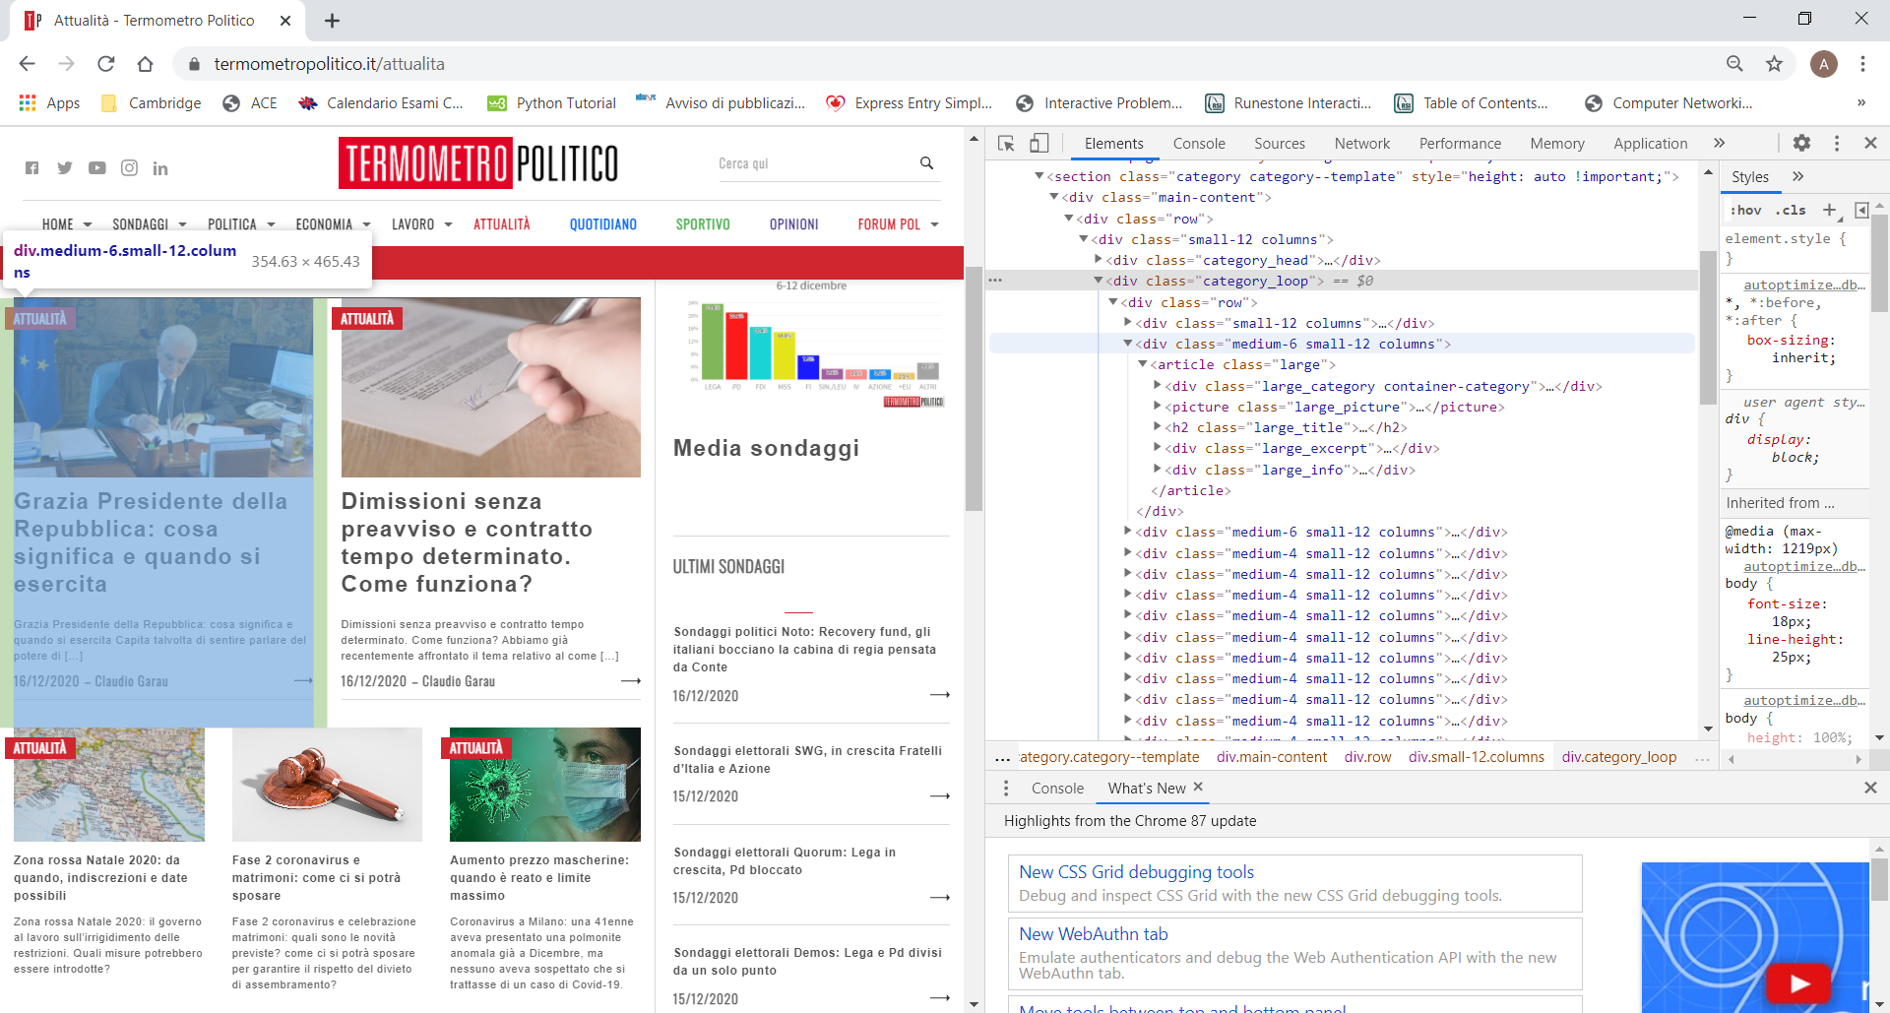
2. Extracting data

Slide 6
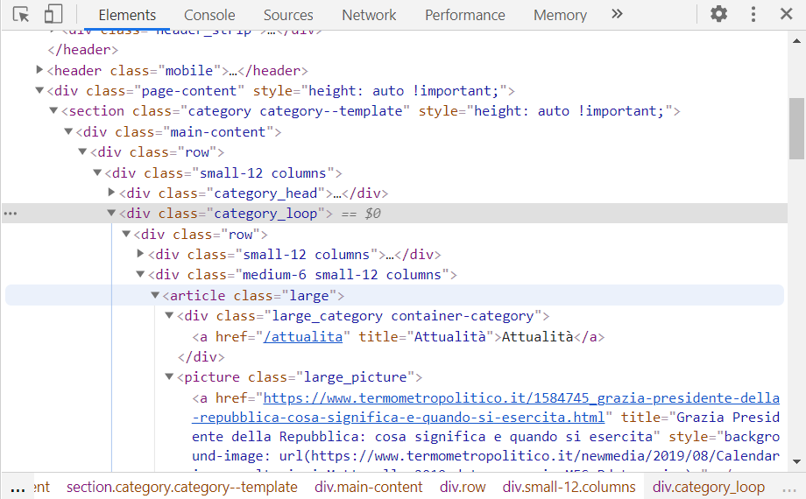
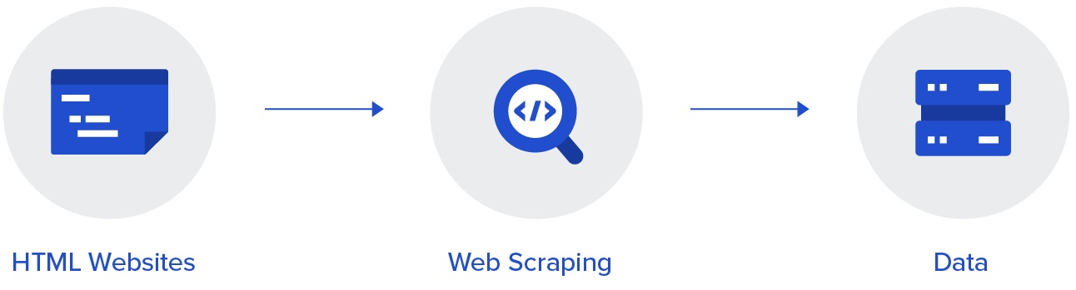
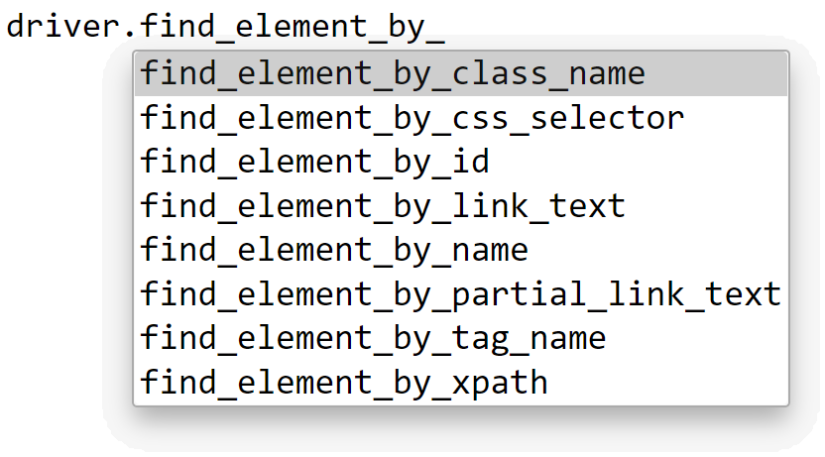
Locating elements from HTML

Slide 7
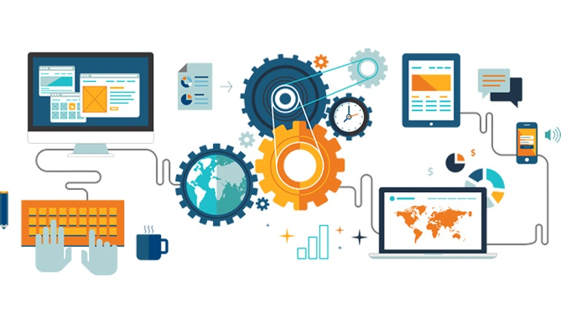
Automation
WebDriverWait()
driver.back()
get URL
extract data
go back
get next URL

Slide 8
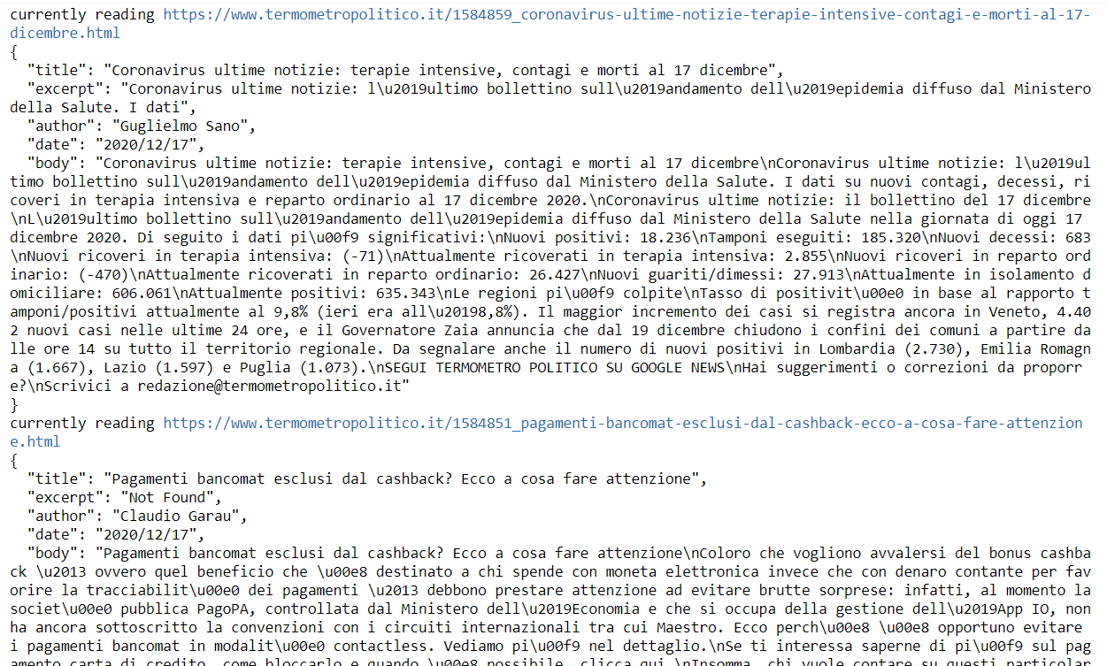
Output

Slide 9
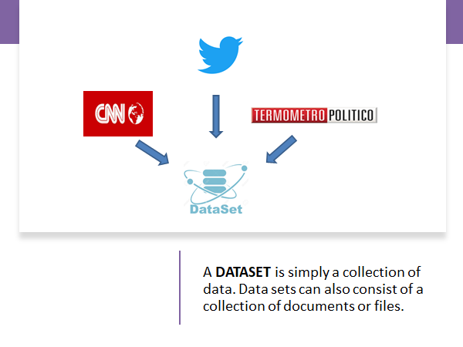

Slide 10

data from T
GATHER DATA FROM TWITTER
Twitter is one of the major places where we express our sentiments about a specific topic or a concept.
Why?
Gathering data from tweets is important for sentiment analysis for next steps in ML groups.

Slide 11

Steps that we have done:
Set up Twitter Development Account & library Tweepy for python
Accessed appropriate tweets via hashtags, using a code to import information in csv format, filtering by language and choosing the amount of tweets to import

Slide 12
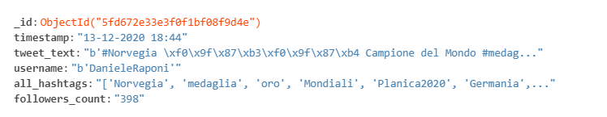
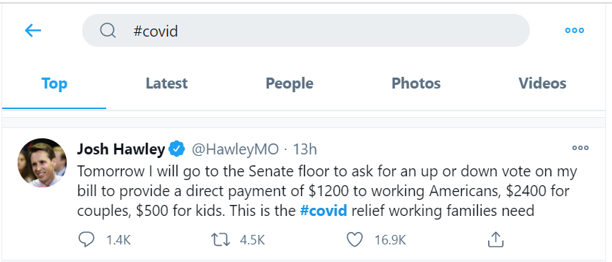
DATA SET OF TWEETS STORED IN DATABASE MONGODB
USER
tweet body
Imported more than 3000 tweets into database to form a full dataset
Used hashtags: #love #economia #travel #politica #news #covid

Slide 13
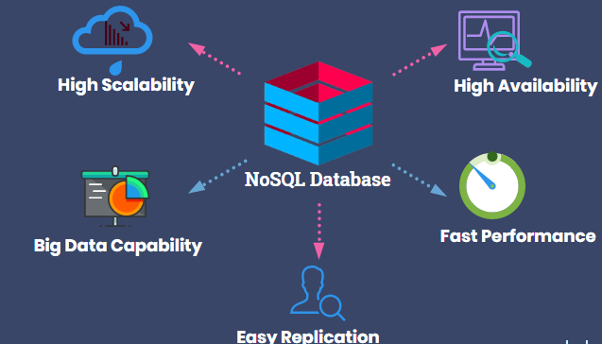
Why did we choose a NoSQL database?
Data storage varies with database type
Dynamic storage
Dissimilar data can be stored together differently from SQL databases
Suitable for structured, semi-structured as well as unstructured data

Slide 14

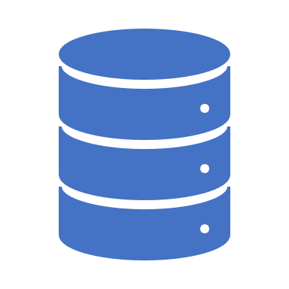





WHY MONGODB?
MongoDB is a noSql database which gives you scalability and flexibility
Very simple to use, MongoDB also supports JSON file
Support of MongoDB ATLAS, a multi-cloud database server that helps you to access faster
Great API for Python
Great reliability
Made up of multiple connections

Slide 15
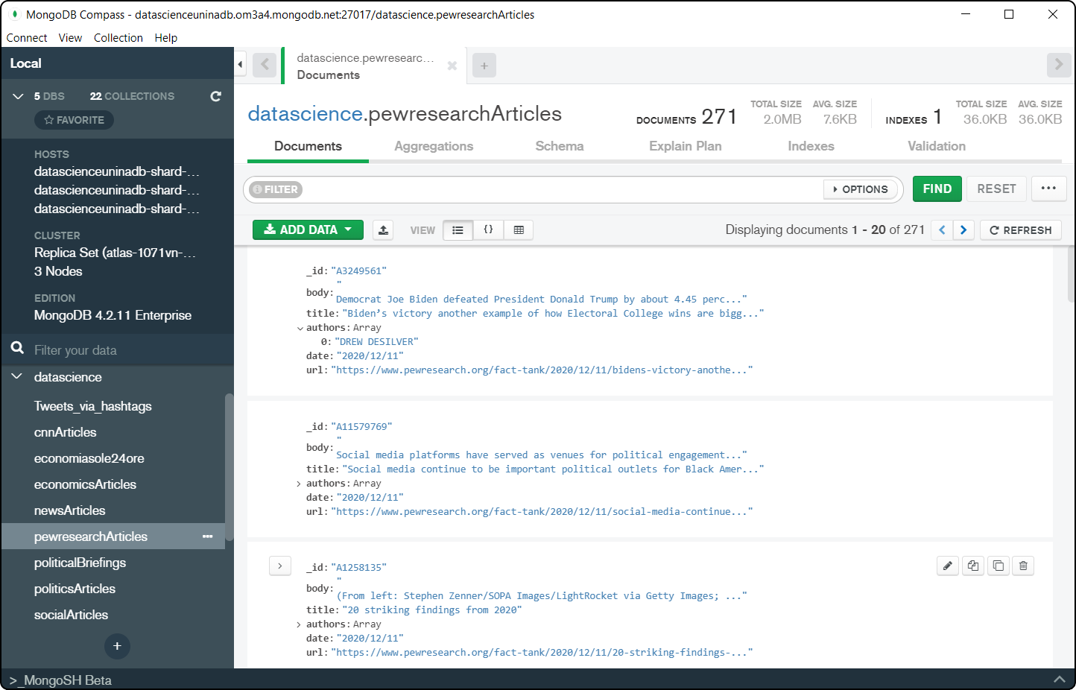
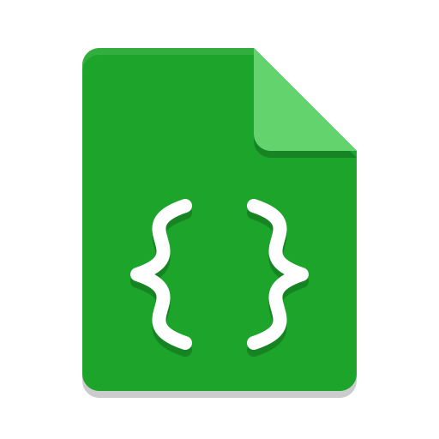
from pymongo import MongoClient
client = MongoClient(<accessData>)
db = client[<dbName>]
table = db[<tableName>]
table.insert_one(data)
Articles stored in json format
List of all collections
Python dictionary stored in ‘data’ variable
All articles are stored in ‘datascience’ db and automatically labelled
Articles are divided by category in different ‘collections’

Slide 16
THANK YOU FOR YOUR ATTENTION!

